Slide 1
Supporting Military
Members in Iowa​

Slide 2


HBI is a program which connects veterans, transitioning service members, and their spouses with the resources and services that meet their specific needs in the State of Iowa.
What is Home Base Iowa (HBI)?

Slide 3

Workforce Solutions
Home Base Iowa (HBI)
Making Iowa a top choice for current and former service members to call home.
Career Planners
Employers
Iowa Employers dedicated to hiring Veterans, Service Members and their spouses
First notice of job opening (LVERs)
Educated on hiring and retaining current and former service members
Career Exploration
Resume review/creation
Interview Training
Connect clients to open positions (HBI Employers)

Slide 4

Employment Benefits
Job search tools and resources
Job placement services
Current labor market reviews
Job readiness programs and training opportunities

Slide 5
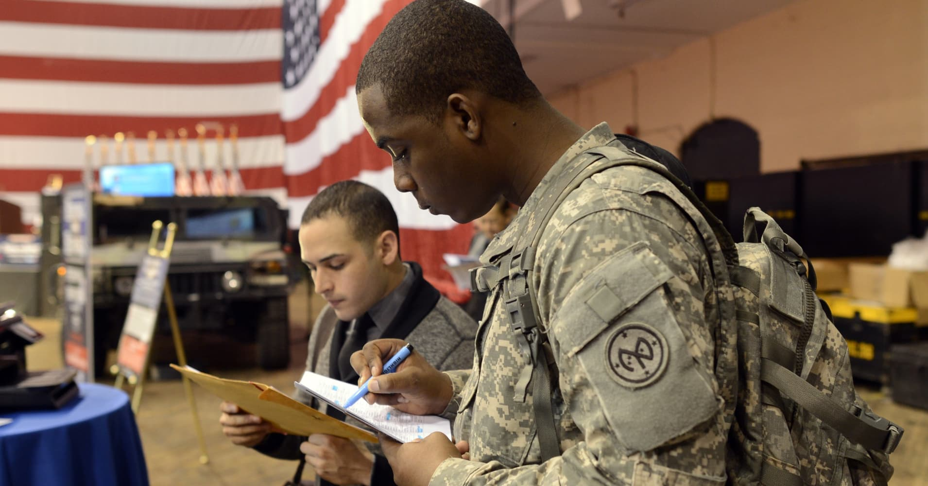
Growth & Recruitment
Home Base Iowa (HBI)
Making Iowa a top choice for current and former service members to call home.
Career Fairs: In-State/Out-of-State
Community Incentive Program
  130+ Communities
  Statewide Incentives
Targeted Marketing Campaigns

Slide 6

Educational Pathways Through CHAMPS
On-campus veteran resources
Military transitional considerations
Financial considerations

Slide 7

Community Incentives
State-wide incentives
  $5,000 home-buying grant, in-state tuition rates, and more
City/County community incentives vary

Slide 8

HBI is a statewide program that aims to connect veterans, transitioning service members, and their spouses with employment services, educational pathways, and community incentives
Conclusion

Slide 9






Thank You
Harrison Swift
Program Manager
515-305-0786
Michael Abramski
Career Planner
515-321-8036
Central Iowa
Noelle Gerrard
Career Planner
515-725-3763
Central Iowa
Cody Bradley
Career Planner
712-233-9030
Western Iowa
HBI@iowa.gov
facebook.com/IowaWORKSforVeterans
linkedin.com/company/IowaWORKSforVeterans
www.homebaseiowa.gov
https://iowaworksforveterans.gov

